Slide 1
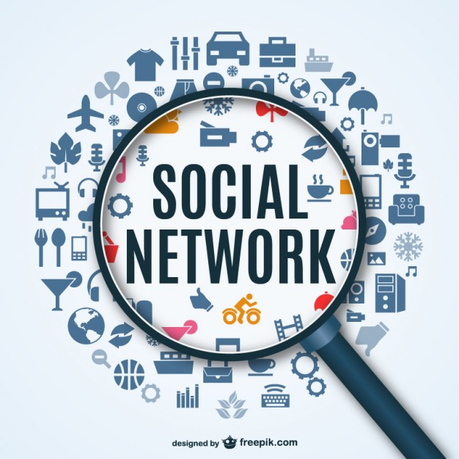
Social Networks Good or Bad
By :Boyang Fu

Slide 2
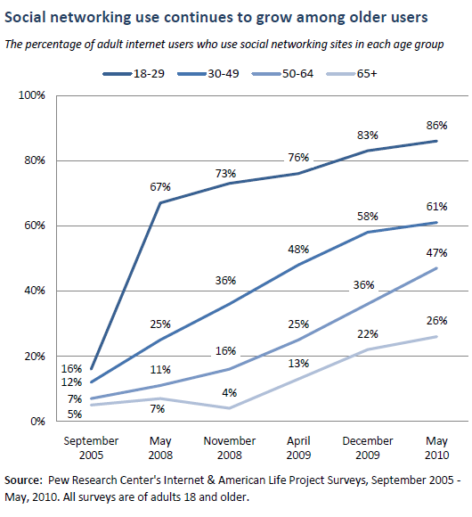
History of Social Networking Sites
SixDegrees.com, which existed from 1997-2001, is considered the first social networking site because it allowed users to create personal spaces and connect to friends online. Friendster, created in 2002, popularized social networking in the United States but was quickly outpaced by other social networking sites such as MySpace (2003), Facebook (2004), Twitter (2006), Pinterest (2009), and Google+ (2012).

Slide 3
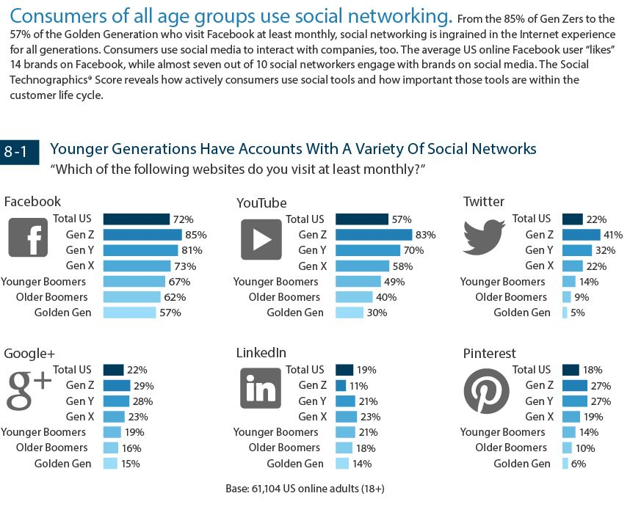
Facebook reached one billion monthly users worldwide on October 4, 2012, making it the most popular social networking site with one in seven people on the planet as members. [142] 71% of online adults in the United States use Facebook. Every day, Facebook manages 4.5 billion "Likes," 4.75 billion content shares, and over 300 million photo uploads. [175] [176] As of Sep. 2014, 51% of US adults use YouTube, 28% use Pinterest, 28% use LinkedIn, 26% use Instagram, and 23% use Twitter. [177] Twitter has 288 million monthly active users and over 500 million tweets are sent daily. [178] Among online adults, use of more than one social networking site increased from 42% in 2013 to 52% in 2014. [26] [174]

Slide 4
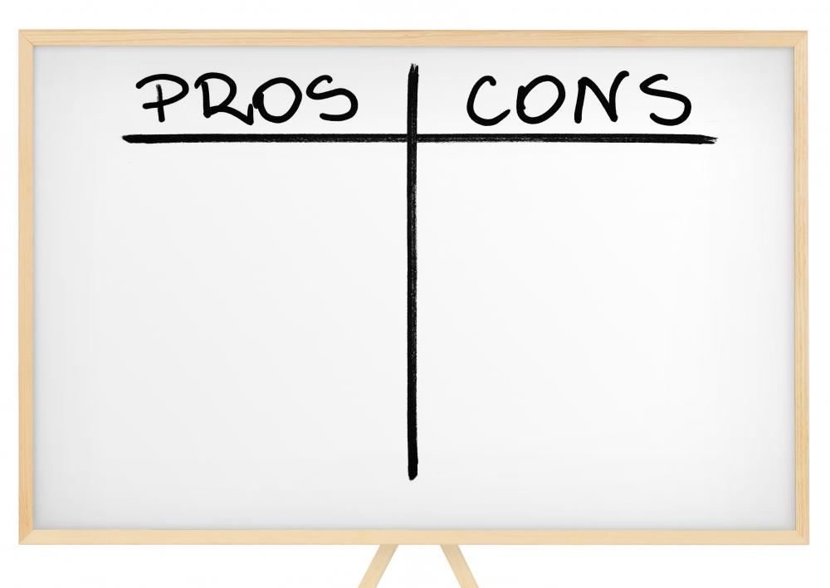
What Have Social Networks Brought Us?

Slide 5
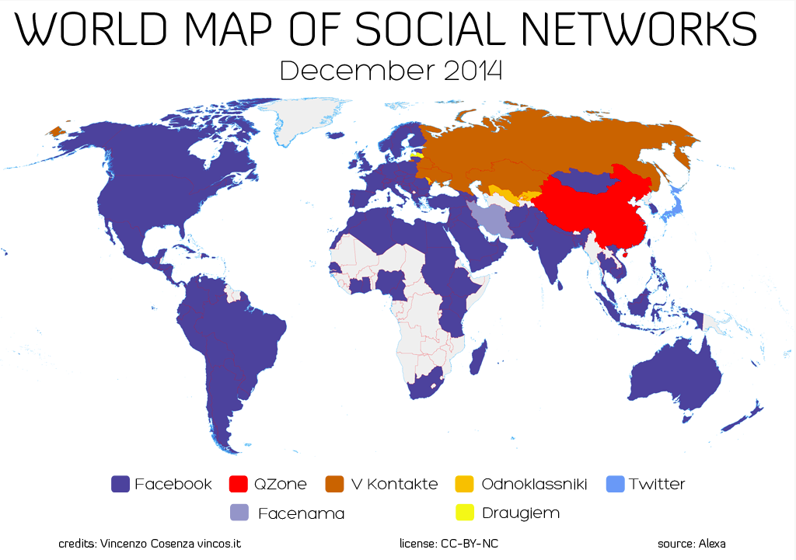
Social networking sites spread information faster than any other media.
PRO
Over 50% of people learn about breaking news on social media. [1] 65% of traditional media reporters and editors use sites like Facebook and LinkedIn for story research, and 52% use Twitter. [2] Social networking sites are the top news source for 27.8% of Americans, ranking close to newspapers (28.8%) and above radio (18.8%) and other print publications (6%). [1] Twitter and YouTube users reported the July 20, 2012 Aurora, CO theater shooting before news crews could arrive on the scene [3], and the Red Cross urged witnesses to tell family members they were safe via social media outlets. [4]

Slide 6
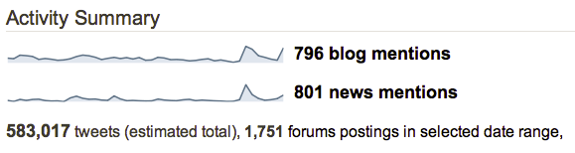
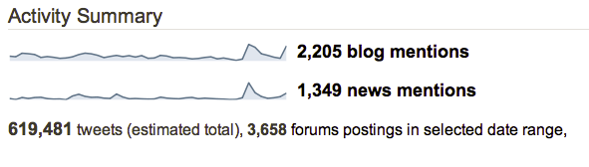
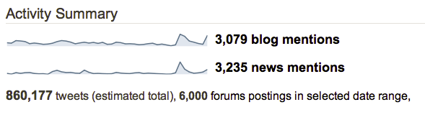
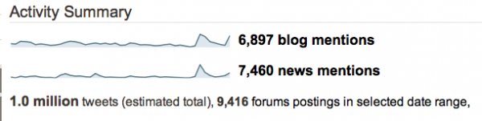
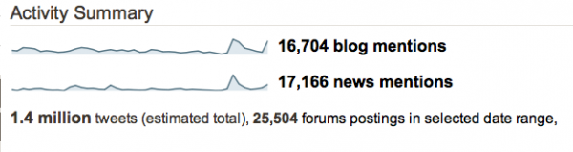
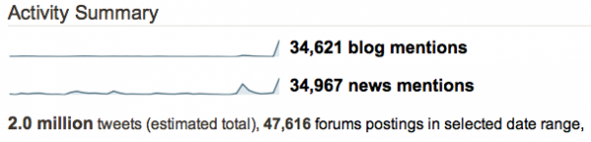
PRO
MAY 2, 2011 – Osama Bin Laden has been found and killed
Midnight(EST):
12:30am(EST):
1am(EST):
2am(EST):
4am(EST):
8am(EST):

Slide 7
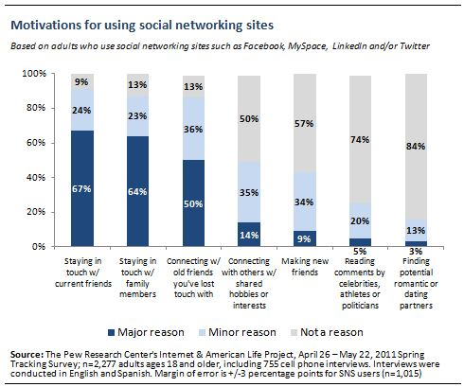
Social networking sites allow people to improve their relationships and make new friends
PRO
70% of adult social networking users visit the sites to connect with friends and family [12], and increased online communication strengthens relationships. [13] 52% of teens using social media report that using the sites has helped their relationships with friends, 88% report that social media helps them stay in touch with friends they cannot see regularly, 69% report getting to know students at their school better, and 57% make new friends. [14]

Slide 8
Staying in touch with family members is a major factor across a range of social media users, but it’s especially important to women
PRO
Those who say that keeping up with family members is a major consideration in their use of social networking sites are a demographically diverse group. Two-thirds of all social media users cite family connections as a major reason for their use of these tools, and there are no major differences on this question in terms of age, income, education, race/ethnicity, parental status or place of residence. The primary difference on this topic pertains to gender, as female social media users are more likely than male users to cite family connections as a major reason for using these sites (72% vs. 55%).

Slide 9
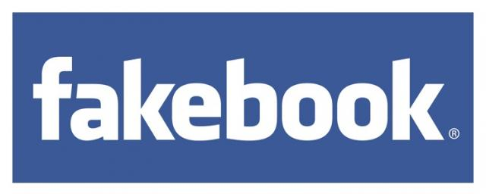
Social media enables the spread of unreliable and false information
CON
49.1% of people have heard false news via social media. [1] On Sep. 5, 2012 false rumors of fires, shootouts, and caravans of gunmen in a Mexico City suburb spread via Twitter and Facebook caused panic, flooded the local police department with over 3,000 phone calls, and temporarily closed schools. [79]Shashank Tripathi, tweeting as @ComfortablySmug, spread false information in the aftermath of Hurricane Sandy by tweeting that the New York Stock Exchange was flooding and that the power company would cut off electricity to all of Manhattan; the bogus information was picked up by national news outlets including CNN and the Weather Channel. [80]

Slide 10
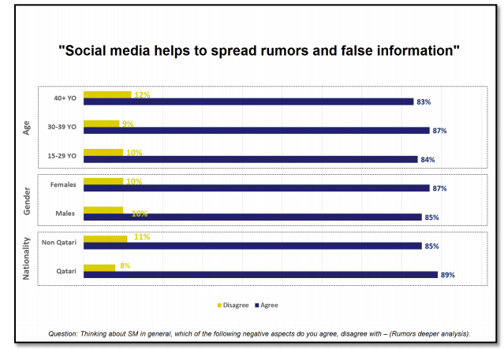
A new study of internet users in Qatar has examined the usage of emerging social media networks.
The most negative aspect of social media identified by the study was that social media is “helping to spread rumors and false information.” 85% of respondents across all ages, genders, and nationalities agreed with this statement.

Slide 11
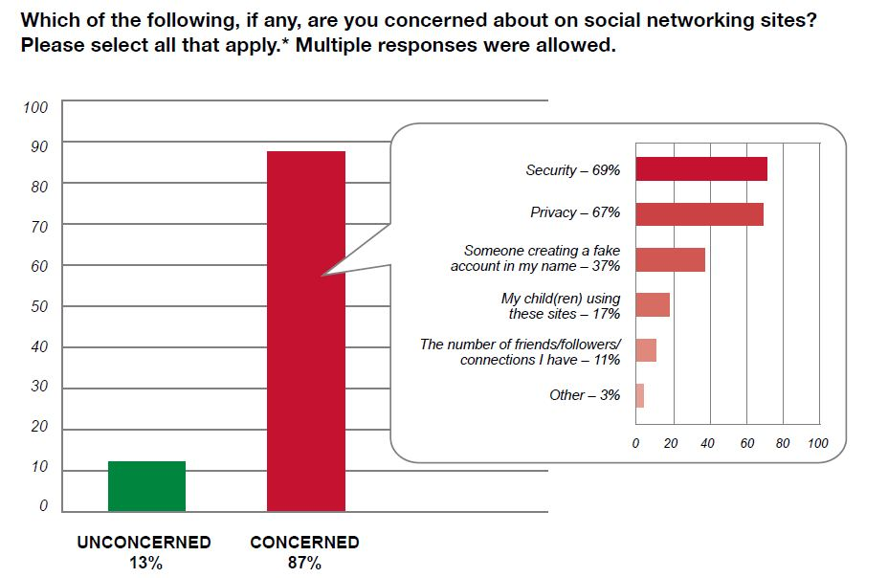
Social networking sites lack privacy and expose users to government and corporate intrusions.
13 million users said they had not set or did not know about Facebook's privacy settings and 28% shared all or nearly all of their posts publicly. [81] The US Justice Department intercepted 1,661 pieces of information from social networking sites and e-mails in 2011. [82] The 2009 IRS training manual teaches agents to scan Facebook pages for information that might "assist in resolving a taxpayer case." 4.7 million Facebook users have "liked" a health condition or medical treatment page, information that is sometimes used by insurance companies to raise rates.[81] [83]

Slide 12
Teens, Social Media, and Privacy
91% post a photo of themselves, up from 79% in 2006.
71% post their school name, up from 49%.
71% post the city or town where they live, up from 61%.
53% post their email address, up from 29%.
20% post their cell phone number, up from 2%.
92% post their real name to the profile they use most often.²
84% post their interests, such as movies, music, or books they like.
82% post their birth date.
62% post their relationship status.
24% post videos of themselves.

Slide 13
Five Hidden Dangers of Facebook
• Your information is being shared with third parties • Privacy settings revert to a less safe default mode after each redesign • Facebook ads may contain malware • Your real friends unknowingly make you vulnerable • Scammers are creating fake profiles

Slide 14
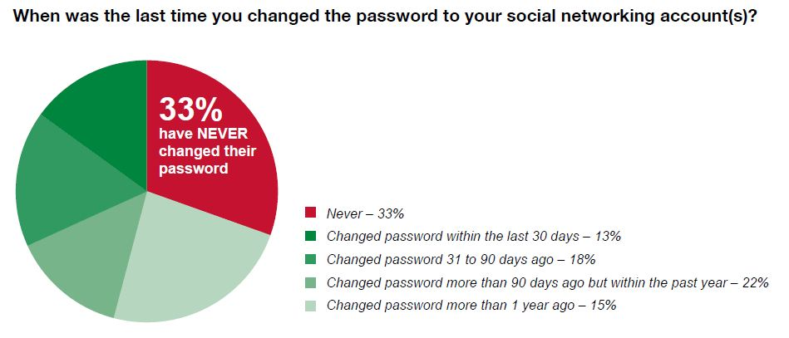
What Can We do?
Many of the Privacy issues are due to the bad habits of using social networks and are avoidable. For example changing the password frequently, try not to upload to much personal information online, changing the default setting and so on
However, the cost of extensive information is the exposure of privacy. You just cannot have 100% information and 100% privacy at the same time.

Slide 15
Reference
[2]:http://socialnetworking.procon.org/#Background & http://www.pewinternet.org/2010/08/27/older-adults-and-social-media/
[3]: http://socialnetworking.procon.org/#Background & http://www.marketingpilgrim.com/2014/01/facebook-is-the-most-visited-social-network-twitter-and-google-tied-for-3rd.html
[5]: http://socialnetworking.procon.org/#Background
[6]: https://blog.sysomos.com/2011/05/02/how-fast-the-news-spreads-through-social-media/
[7]: http://www.pewinternet.org/2011/11/15/why-americans-use-social-media/ & http://socialnetworking.procon.org/#Background
[8]: http://www.pewinternet.org/2011/11/15/why-americans-use-social-media/
[9]: http://socialnetworking.procon.org/#Background
[10]: http://blogs.worldbank.org/publicsphere/five-key-findings-how-people-use-social-media-qatar
[11]: http://www.welivesecurity.com/2011/06/22/the-social-networkingcybersafety-disconnect/ & http://socialnetworking.procon.org/#Background
[12]: http://www.pewinternet.org/2013/05/21/teens-social-media-and-privacy/
[13]: http://www.cbsnews.com/news/five-hidden-dangers-of-facebook/

